Slide 1
TAS 152
LECTURE 3
TOPIC 1
CYBER SOCIETY: CORE VALUES AND VIRTUES
1.3 THE FOURTH INDUSTRIAL REVOLUTION

Slide 2
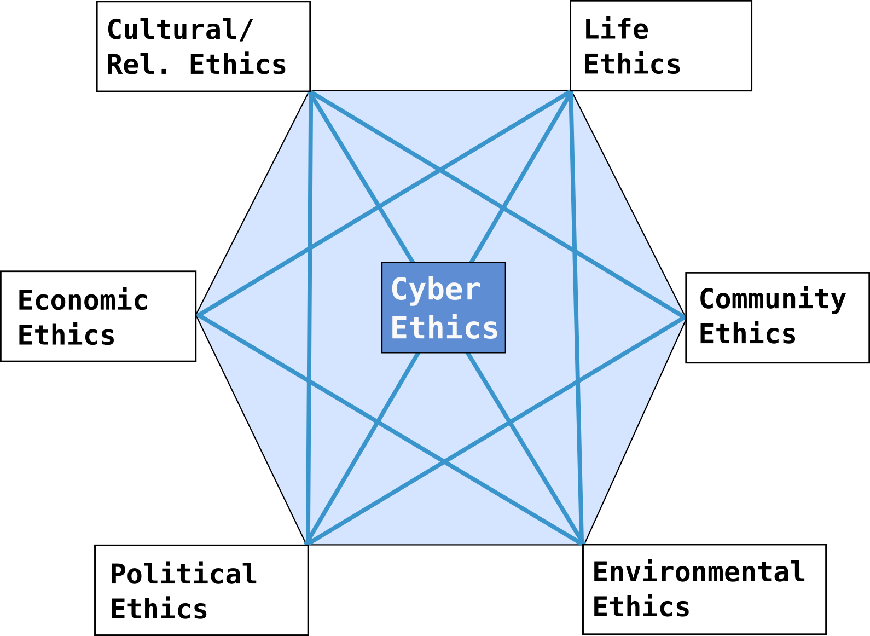
RECAP

Slide 3
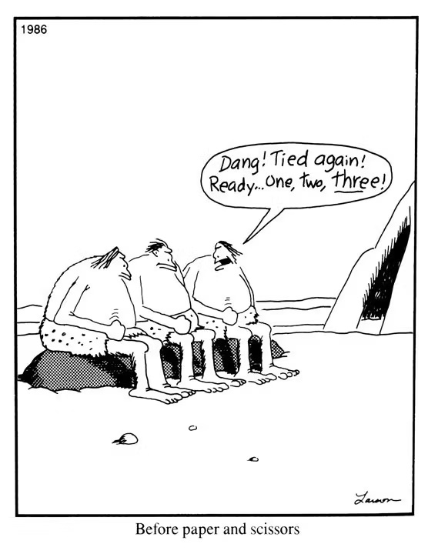
THE FOURTH INDUSTRIAL REVOLUTION
What does it mean when an "industrial revolution" occurs?
What happened prior to the Fourth Industrial Revolution?
What are the effects of an industrial revolution?
Why is it important for you to know about the Fourth Industrial Revolution?
Before paper and scissors were invented...

Slide 4
THE FOURTH INDUSTRIAL REVOLUTION
What is an "industrial revolution"?
An industrial revolution describes a process of economic transformation initiated by the adoption of novel technologies.
Note "adoption" not just "invention"

Slide 5
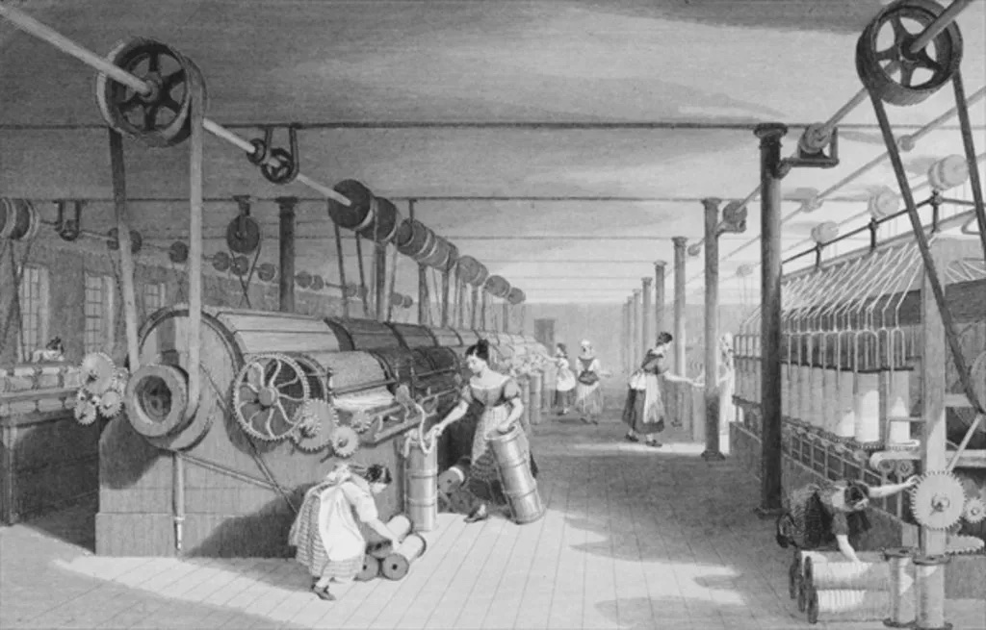
THE FIRST INDUSTRIAL REVOLUTION (late1700s - early1800s)
Before the first industrial revolution
Humans were focused on agricultural practices.
After the first industrial revolution
Large scale industrialisation
Steam power to support iron and textile production.

Slide 6

THE SECOND INDUSTRIAL REVOLUTION (1870 - 1914)
Before the second industrial revolution
Steam-powered
Slow
Manufacturing processes were complicated
Lots of human involvement needed.
After the second industrial revolution
Standardisation
Mass-production
Industrialisation.
New steel-making processes, machine tools and assembly lines were key elements of new automated processes.

Slide 7
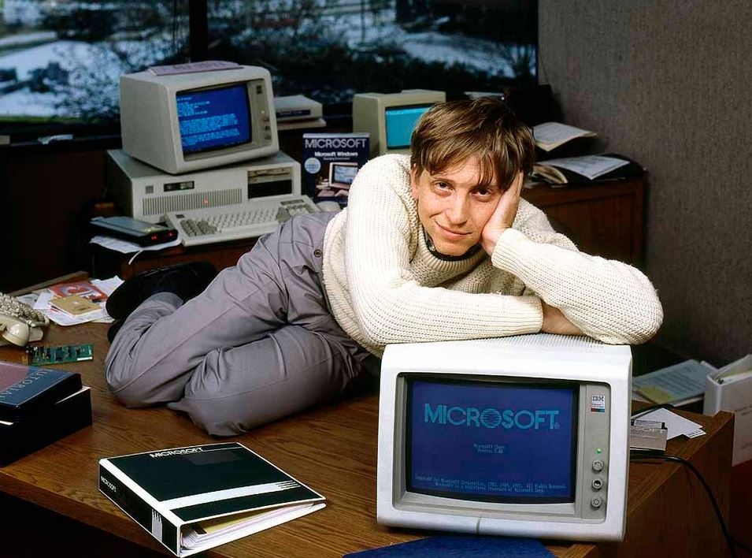
THE THIRD INDUSTRIAL REVOLUTION (1970s – early 21st century)
Before the third industrial revolution
No such thing as "instant communication"
Movies had to be seen in cinema
Books/print dominant form of media
Technology was expensive, meant for military, academic or very wealthy individuals
After the third industrial revolution
Digital computing and communication technologies became widely available.
ATMs, mobile phones, and digital cameras.
Birth of the Internet
World Wide Web was a further key development.

Slide 8

THE FOURTH INDUSTRIAL REVOLUTION (21st century - ongoing)
Before the fourth industrial revolution
Technology existed and it was prevalent, but it was not connected
After the fourth industrial revolution
Increased connectivity
Smart phones, smart sensors, location detection technologies.
Big data analytics
Smart automation of value chains,
Digitisation of products and services
Development of new business models

Slide 9
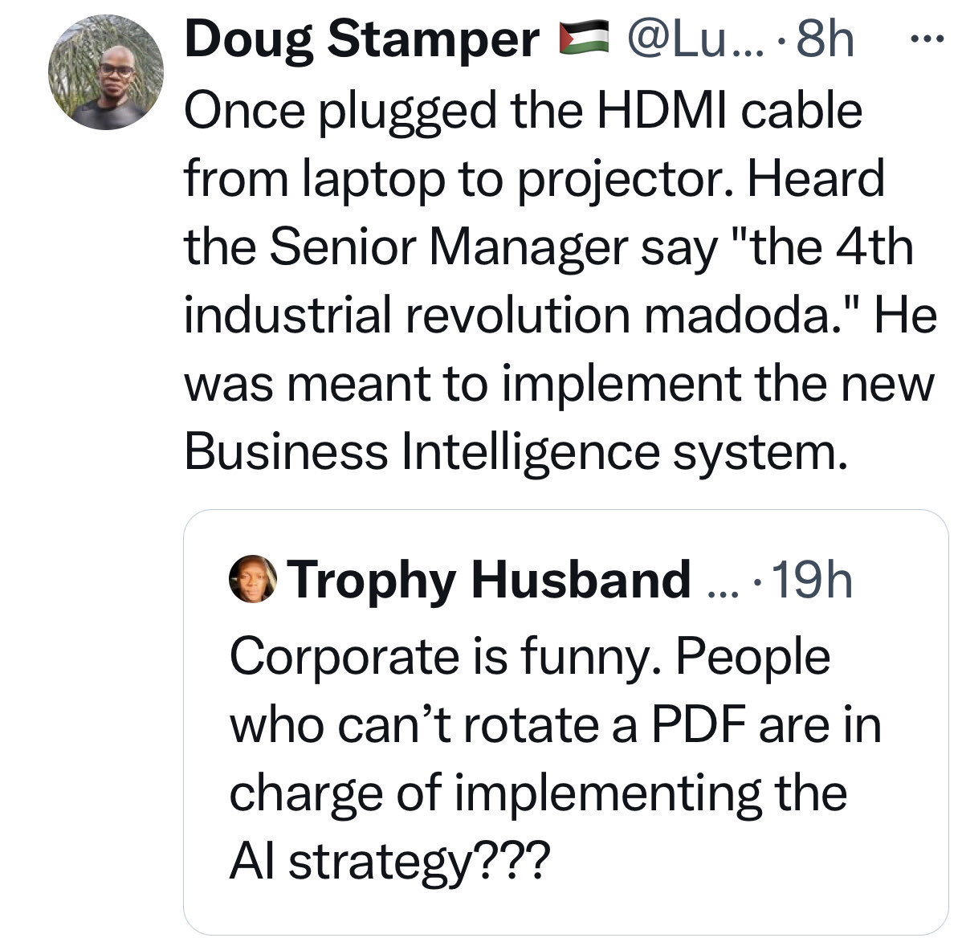
WHAT THE FOURTH INDUSTRIAL REVOLUTION IS NOT

Slide 10
THE IMPACT OF DISRUPTIVE TECHNOLOGIES
What are examples of disruptive technologies?
Artificial intelligence (ChatGPT, Stable Diffusion)
Blockchain (Bitcoin)
Streaming (Netflix, Showmax)
Social media (Facebook, Twitter)
E-commerce (Amazon, Takealot)
3D printing
E-hailing (Uber, Bolt)
Two levels of technological disruption: First and second order
First order
Localised changes within a particular market or industry
Second order
Social relationships, organisational structures, public policies and the physical environment.

Slide 11
THE IMPACT OF DISRUPTIVE TECHNOLOGIES – E-HAILING
FIRST ORDER | SECOND ORDER
Traditional taxi business have less market share Drivers that used to work for traditional taxi businesses might leave for e-hailing companies | Worker's rights are debated/protested i.e. are they contract workers? New laws need to be developed The safety of e-hailing is called into question

Slide 12
THE IMPACT OF DISRUPTIVE TECHNOLOGIES - STREAMING
FIRST ORDER | SECOND ORDER
DVD and CD sales drop dramatically DVD rental stores close New streaming only series/movies are produced | Actors/musicians protest regarding how they receive royalties for shows Problems about quality versus quantity in the entertainment industry Sharing of accounts amongst users

Slide 13
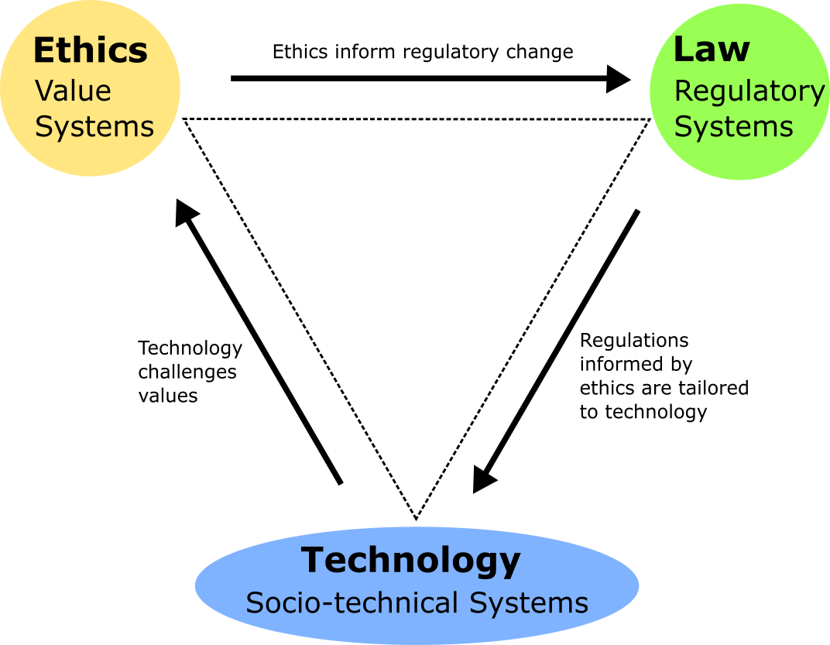
THE IMPACT OF DISRUPTIVE TECHNOLOGIES

